Slide 1

Deposit Return Scheme
Registration Workshops

Slide 2
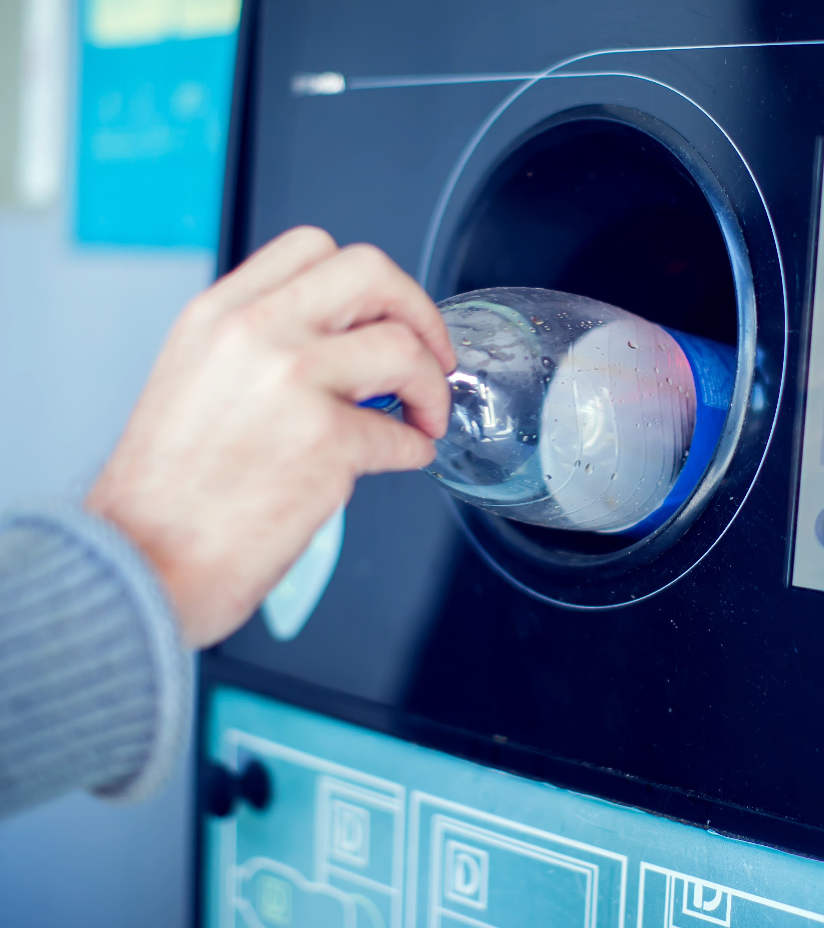
Welcome
Thank you for joining us today

Slide 3
Agenda
Today we will cover:
      Stakeholder Landscape
      Scheme overview
      Producer Registration
      RPO and Hospitality Registration
      Exemptions
      Cutover
      Mythbusters
      Q&A

Slide 4




Operational Context
  Less than 7 month to ‘Go Live’
  - and the scheme is going live
  All, including Government, SEPA and CSL, acknowledge it is a big challenge
  Do what you can
  - you will be supported
  Set up by industry to deliver the legislation as passed
  - our job is to make the rule book happen
  - not to change it
  - so we’re not discussing change in scope or change in dates

Slide 5
Stakeholder Landscape

Slide 6
Stakeholder Landscape
Producers
Retailers/
Hospitality
Wholesalers
Consumers
Pan-Scheme Players
SEPA
Circularity Scotland
Scottish Government
ZWS

Slide 7
The role of each player to meet the regulations
Producers
Scheme Administrator (SA)
Register company and product/container details
Register producer with Regulator
Register RPO
with Regulator
Charge deposits
Refund deposits to return points
Provide forecasts and details of products Placed on Market
Pay RHF to return points/takeback operators
Collect packaging from the return points
Meet recovery targets
(80%, 90%)
Pay deposits and Producer Fee
Sell registered products
Charge deposits (display value separately)
Operate a return point & refund deposits
Retain returned packaging for SA to collect
Retailers/Hospitality
Return Point Operators

Slide 8


Registration Timelines
01/12/2022 to 28/02/2023
Producer
01/03/2023 onwards
Return Point Operator

Slide 9
Producer Obligations
As a producer you must:
Register with SEPA
Pay the registration fee
Charge a 20p deposit on each scheme article you make available in Scotland
Arrange for collection of your empty scheme containers
Pay a reasonable handling fee to retailers and return point operators to cover the cost of collection/storage at return points
Meet collection targets
Refund deposit to customers

Slide 10
The role of Circularity Scotland
Scheme Administrator
Primary Role: to take on producer responsibilities for:
collection of materials
recycling of collected materials
payment of fees
achieving the required performance levels
meeting ScotGov targets
Secondary Role: to act as co-ordination point:
through Go Live
the effective running of the scheme

Slide 11
The role of Circularity Scotland
What we will do
Define the overall operating model, rules and standards
Submit your registration to SEPA on your behalf
Manage payments from producers and to return point operators
Track the issued and returned containers across the scheme
Collect returned containers from return points across Scotland
Process and sell the returned material
Market and communicate the scheme

Slide 12
Scheme Overview

Slide 13
Current Collections Profile
​Volume for collection = approx. 3bn scheme articles per annum (PET/Alu/Glass)
Assuming 80% capture rate in year 1
Scheme Target is 90% capture rate
Item - No. Of Producers/RPO Type | Units
Producers | 4,500
Number of SKUs/EANs | 30,000
Number of Total Return Points | 28,715
Aiming for | <20,000
Number of Manual Return Points | 11,547
Number of Automated Return Points | 3,709
Number of Closed Loop Return Points | 13,459

Slide 14
RVM Returns Process
Pet/Alu scanned and crushed
Placed in segregated or co-mingled bags within storage bins
Once full*, close and seal with barcoded security tags
Replace with empty sack
Place bags / bins in secure designated uplift area
Ensure ensure area is clear of obstruction ready for uplift
Consumer returns scheme article
Deposits into RVM
Glass scanned and broken into bins
If mechanical breakage used fragments > 10mm must be achieved
Once bin is full close lid and tag
Remove from RVM and replace with empty bin
*Bag capacity should be set with RVM manufacturer and comply with manual handling regulations where appropriate. Leave 30cm of empty space to allow bags to be closed and tagged

Slide 15
Manual Return Point Process
Empty residue liquids
Place returned Pet/Alu scheme articles into plastic sacks
Do Not Crush Pet/Cans
Once plastic sacks are full close and seal with barcoded security tags
(leave 30cm empty so bag can be sealed)
Consumer returns scheme article to RPO location –
Operator checks item is within scheme and pays deposit
Place bags / bins in secure designated uplift area
Ensure area is clear of obstruction ready for uplift
Empty residue liquids
Place returned glass scheme articles into tote boxes
(stack bottles to maximise fill)
Do Not Break Glass
Once tote is full close lid and seal with barcoded security tags

Slide 16
Closed Loop Process
Empty residue liquids
Place returned Pet/Alu scheme articles in plastic sacks
Do Not Crush Pet/Cans
Once plastic sacks are full close and seal with barcoded security tags
(leave 30cm empty so that bag can be sealed)
Place bags / totes / bins in secure designated uplift area and ensure area is clear of obstruction ready for uplift
Glass bins will be weighed by collection driver prior to tipping into vehicle)
Scheme articles are retained at RPO location
Empty residue liquids
Place returned glass scheme articles in bins or tote boxes
(double stack bottles to maximise fill)
Do Not Break the Glass in tote boxes
Once tote is full close lid and seal with barcoded security tag
Close bin lid
Bulk glass collection will be available where accurate sales or purchase data can also be provided. Details to be issued shortly.

Slide 17















Collection Mode – RVM/Manual/Closed Loop
Glass
RVM
PET/Cans
PET/Cans
3rd party DC
Re-processing
Plant
Backhaul
Glass
Bulking/Counting Centres
PET/Cans
Manual RPO/Hospitality
Glass
Larger Hospitality Glass
The business type and collection frequency will be agreed following the RPO registration process.

Slide 18
Collection Frequency
Business type | Collection frequency
Small retail e.g. newsagent operating as a manual return point | 1 – 2 per fortnight
Medium retail e.g. larger convenience stores operating as manual or RVM | 1 - 2 per week
Large retail e.g. supermarkets operating RVM returns | 5 – 7 per week
Small hospitality (manual returns) | 1 – 2 per fortnight/On Demand
Medium hospitality (manual returns) | 1 - 2 per week
Large hospitality (manual returns) | 5 – 7 per week
Ad Hoc | Subject to 3 days’ notice
The above table provides an example of the collection frequency. The business type and collection frequency will be agreed following the registration process. This collection frequency will be reviewed once the scheme is live and volume data of returns including number of bags & totes is modelled and feedback gathered from RPOs. Collection profile may then be adjusted once steady state has been achieved and seasonal variations considered.
​

Slide 19
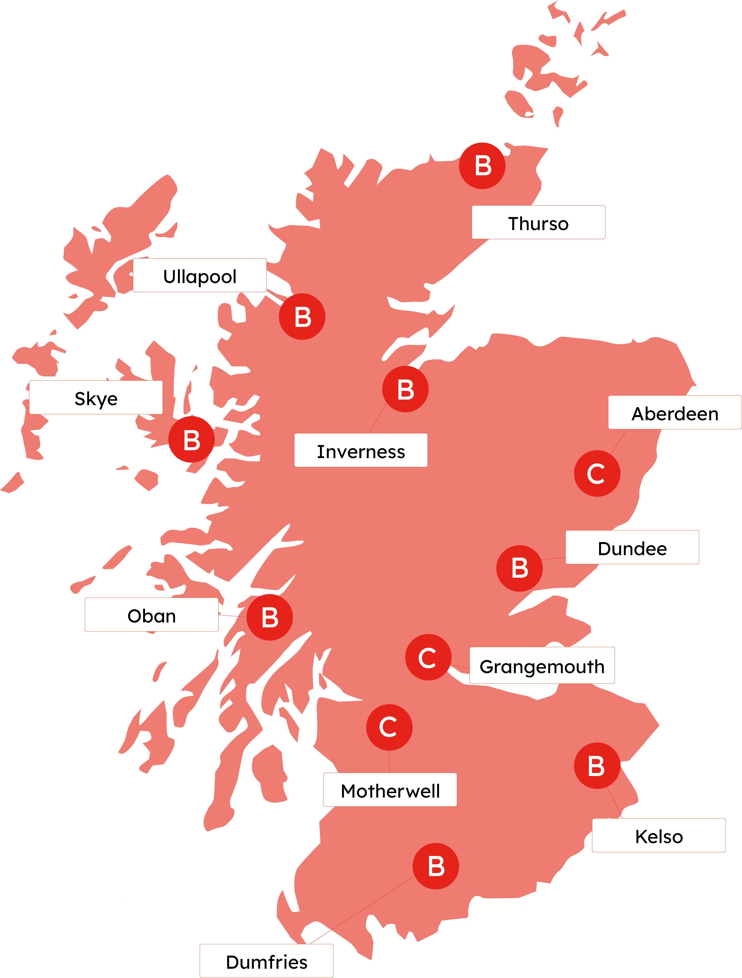
DRS Infrastructure
​Infrastructure build confirmed and making good progress
Ready to deliver for scheme Go Live
3 x Counting Centres
Bulking Centre operations strategically placed across Scotland
Strategically located across Scotland

Slide 20
Producer Registration Process

Slide 21



The SCOTLAND DRS REGULATION
Scheme Articles
OR
PET
Glass
Importer
Brand Owner
Metal
Does it apply to you?
You are a Producer
50ml to 3L
Made available to be marketed, offered for sale or sold by the producer for the purposes of its retail sale in Scotland.

Slide 22
Starting the CSL Registration Process
Producer Journey
Create Account
Login
Enter Org Details
Enter Addresses
Enter Contacts
Sign Agreement
Register Products
Review Summary & Submit
Pay Fee
Return Point Operator Journey
Create Account
Login
Enter Org Details
Enter Addresses
Enter Contacts
Sign Agreement
Enter Return
Points
Review Summary & Submit
Check out the registration process information on the CSL website prior to starting the process
It includes FAQs, information on the data to be collected, screen shots and timings;
It is advised that Producers and Return Point Operators prepare and collate the required information in advance of starting the process

Slide 23
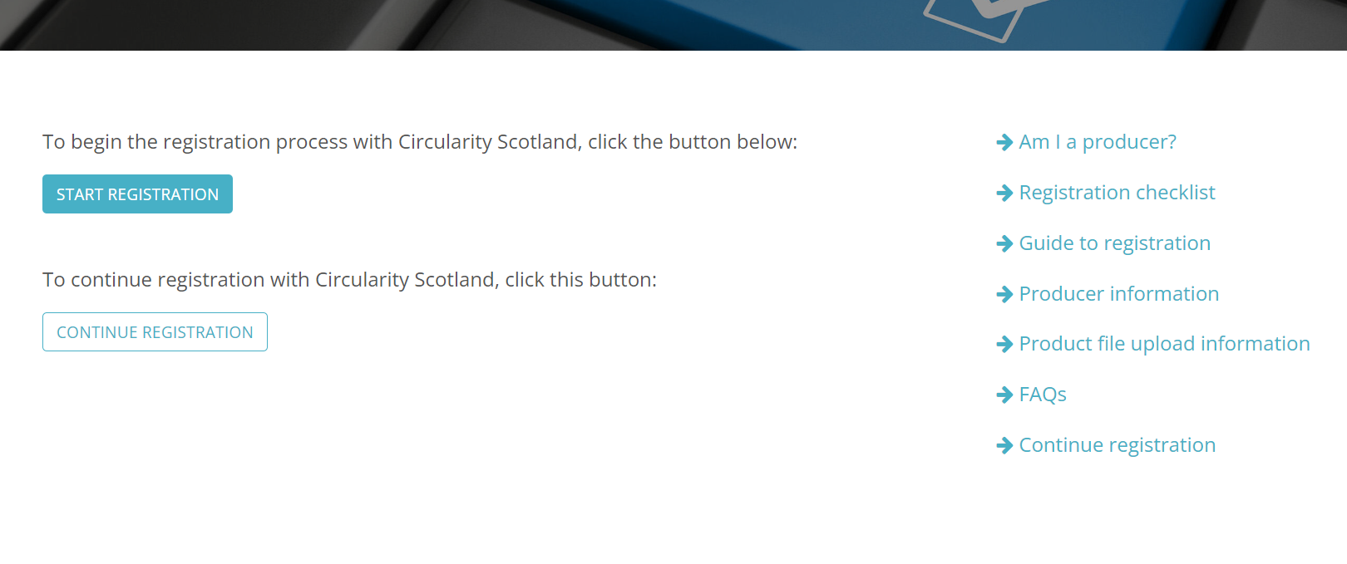
Producer Registration and Supporting Links
Helpful links and tools

Slide 24
Starting the CSL Registration Process
A user account must be created to start the registration process:
You will be asked for an email address and password.
A verification email address will be sent to allow activation.
The user that starts the process will be identified as the main producer contact
If you already have an account you can login to start the registration process
If you have any technical difficulties creating an account, use the ‘Contact us’ form. Our Customer Service team will assist with your request.

Slide 25
What you will need
Details about you as Producer- Brand Owner or Importer?
Details about your organization
Designate Main Contacts, Approvers and Users
  Up to 4 contacts can be added
  Approvers can sign Producer Agreement
  Users can upload products
Producer Agreement- Review and sign
Details for product upload
A payment card to pay the £365 registration fee

Slide 26
Producer Registration
Eligibility
What type of producer are you?
Brand owner – drinks produced in UK
Importer of drinks branded outside UK
If you’re unsure contact Customer Service and they can help

Slide 27
Producer Eligibility
Who do you sell your products directly to?
Scottish customers through own shop
Scottish customers through online retail store
Scottish retailers or hospitality businesses
Wholesalers selling into Scotland

Slide 28
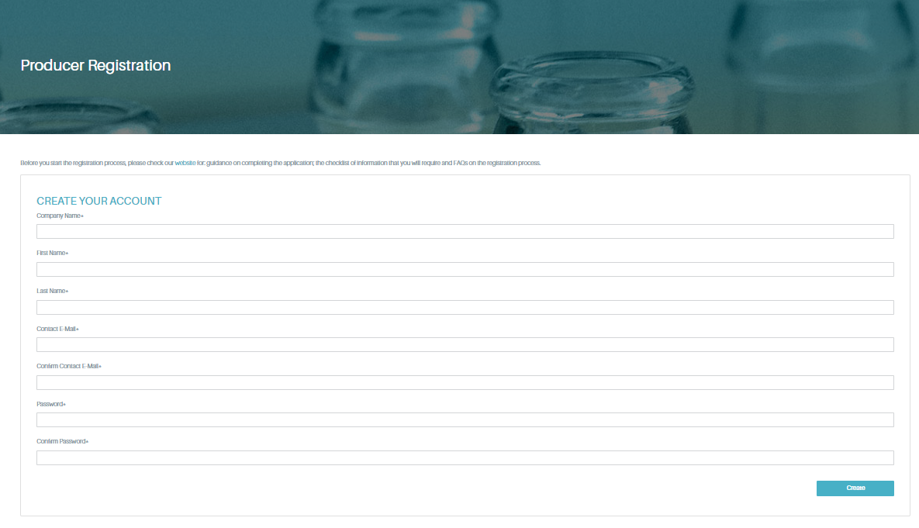
Producer Registration
  Unable to progress without selections being made
  More than one selection can be made for each section
Select blue ‘Forward’ button

Slide 29
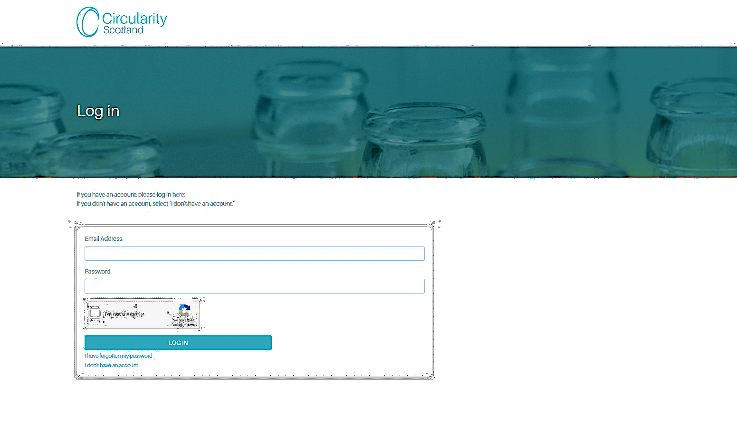
Log In
Enter email address
Enter password
Tick ‘I am not a
Robot’ box
Blue ‘Log in’ box
‘I have forgotten my password’ link
‘I don’t have an
account’ link

Slide 30
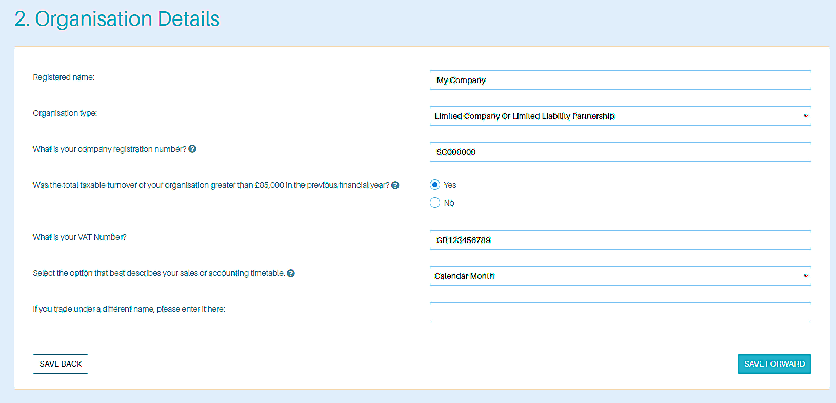
Organisation Details
Registered name
Organisation type
Registration number
Turnover Y/N option
VAT number
Accounting timetable
Trading name
'Save Back’
'Save Forward’

Slide 31
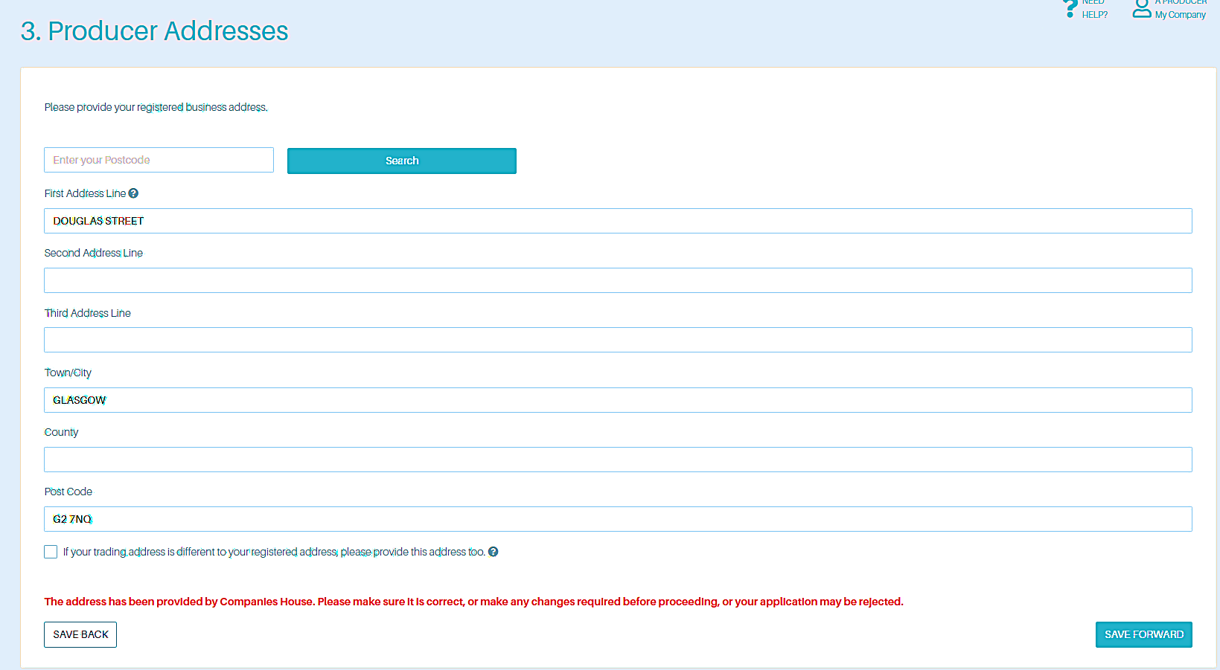
Producer’s Addresses
Enter/search for postcode
If required enter address details
Tick to enter trading address if applicable
'Save Back’
'Save Forward’

Slide 32
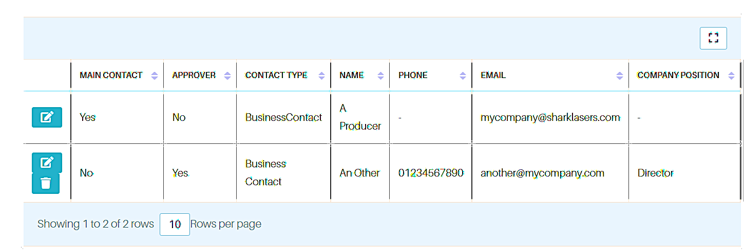
Business Contacts

Slide 33
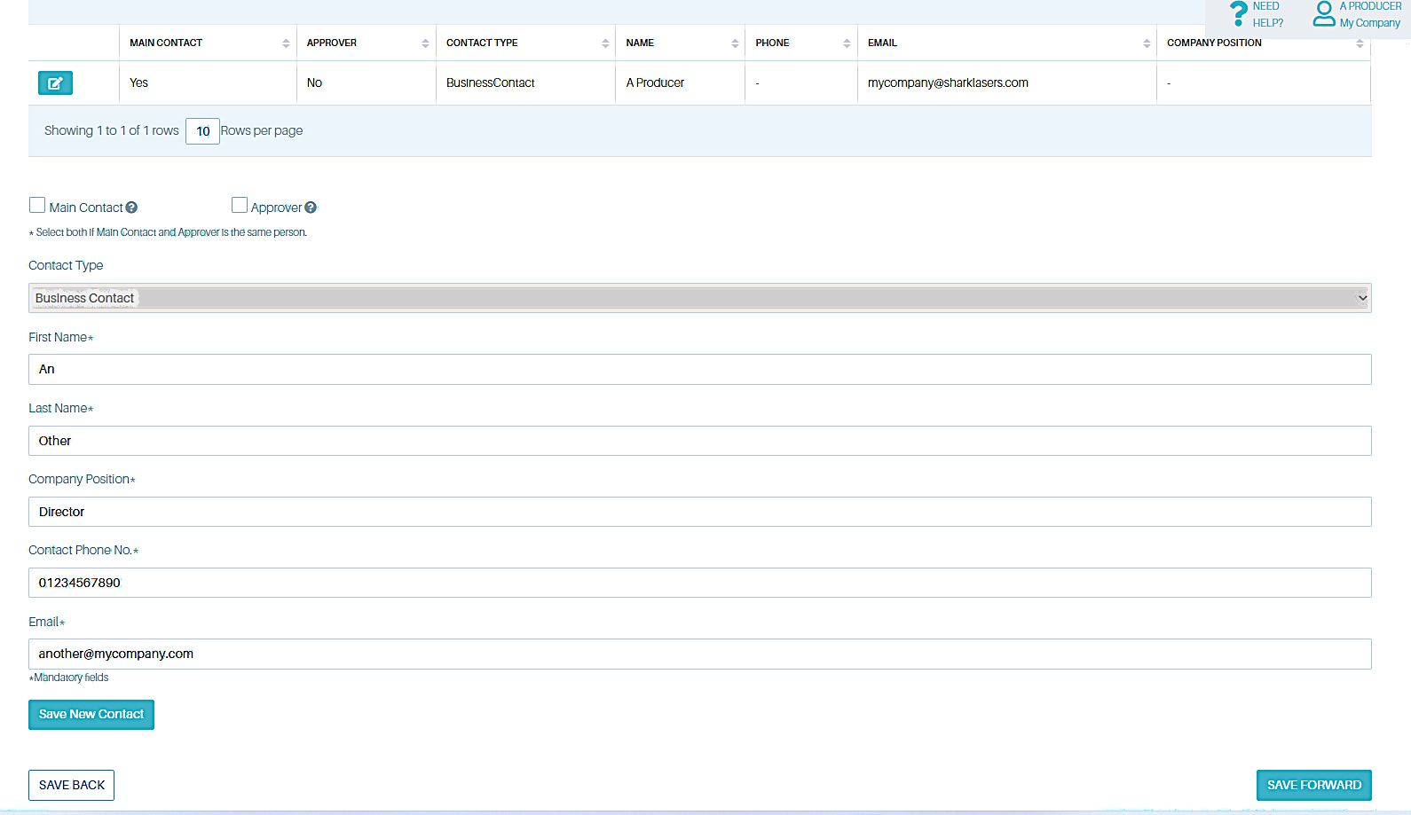
Business Contacts
'Save New Contact’
'Save Back’
'Save Forward’

Slide 34
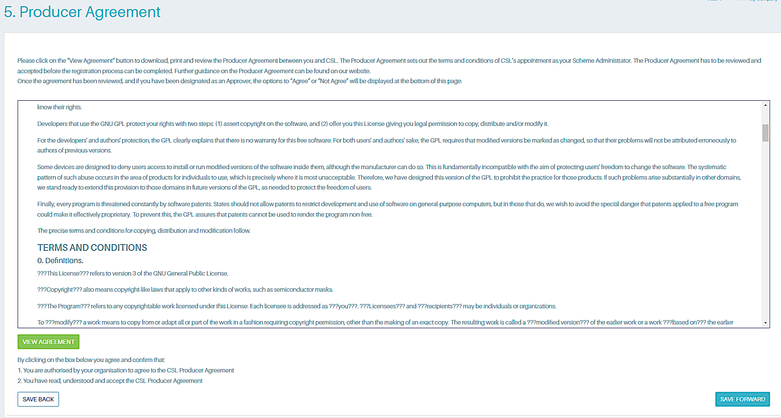
Producer Agreement
‘View Agreement’
'Save Back’
'Save Forward’

Slide 35
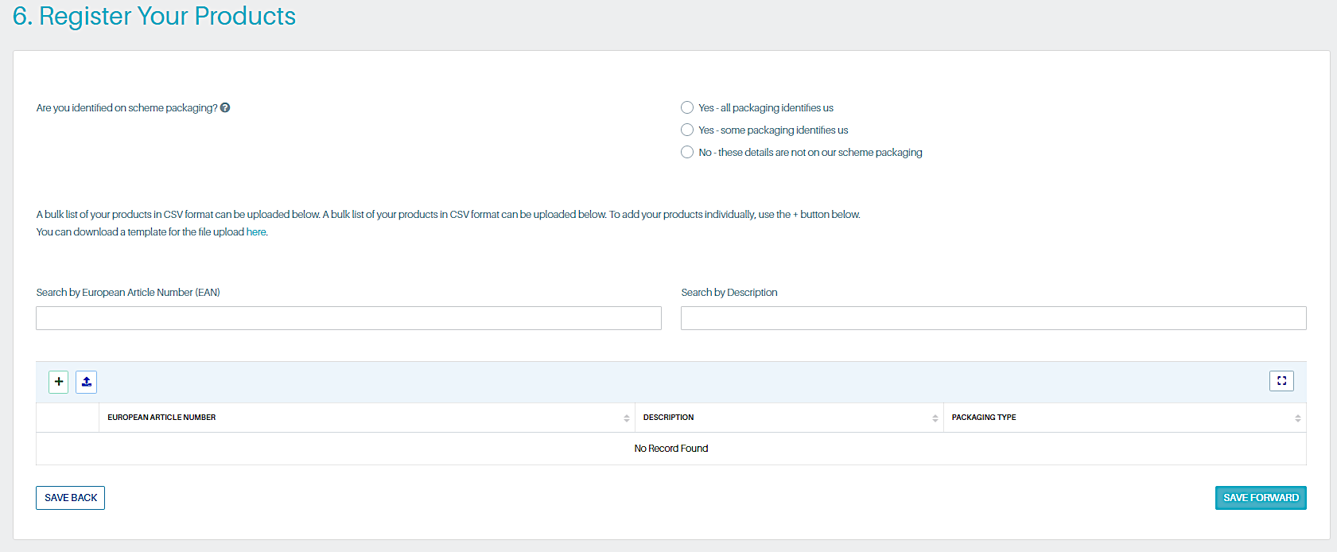
Register Your Products
Tick the relevant box to confirm if all, some or none of your products identify you
You can upload a bulk list of your products here
Click ‘+’ to add products individually
'Save Back’
'Save Forward’

Slide 36
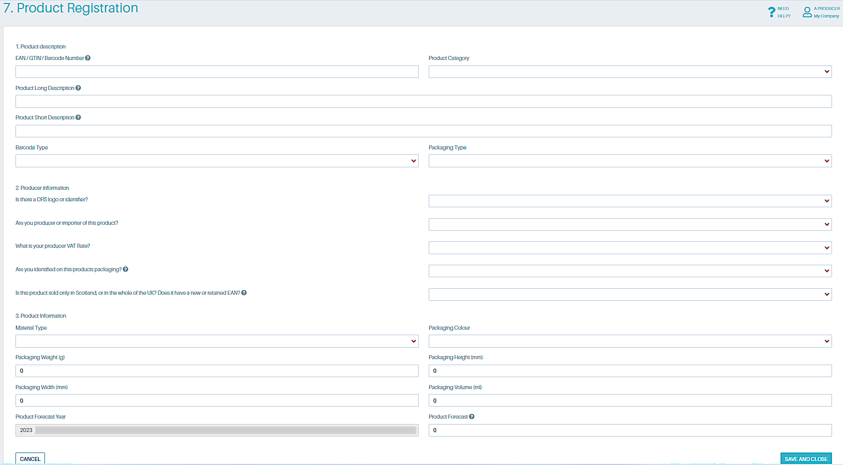
Register Your Products
Enter product description
Enter producer information
Enter product information
'Save Back’
'Save Forward’

Slide 37
Register Your Products
Registration is now open
  producers can register via Circularity Scotland or directly with SEPA
Existing producers selling into Scotland must register by end Feb
  every year including 2023
You are strongly encouraged to meet this deadline
Limited time before Go Live – a huge amount of work to prepare
After the registration window closes – there is an increasing risk your registration will not be completed before launch.

Slide 38
Register Your Products
Registration of scheme articles allows greater understanding around products and volumes within the Scottish market
This assists with planning collections, scheme administration, etc.
We recommend you register with known product information by the end of February
There will be opportunity to update product information after the closure date.

Slide 39
Register Your Products
Registration is open after end Feb (every year) for NEW producers selling into Scotland
Drinks producers that don’t sign-up before the 1 March deadline risk not being able to sell their products in Scotland
After the registration deadline, SEPA will publish and maintain a list of producers registered to market and sell their drinks in Scotland
Retailers, wholesalers and hospitality businesses can check this to ensure they only sell scheme approved products from registered producers
Once the scheme goes live SEPA will carry out audits, inspections, and support producers to achieve compliance

Slide 40
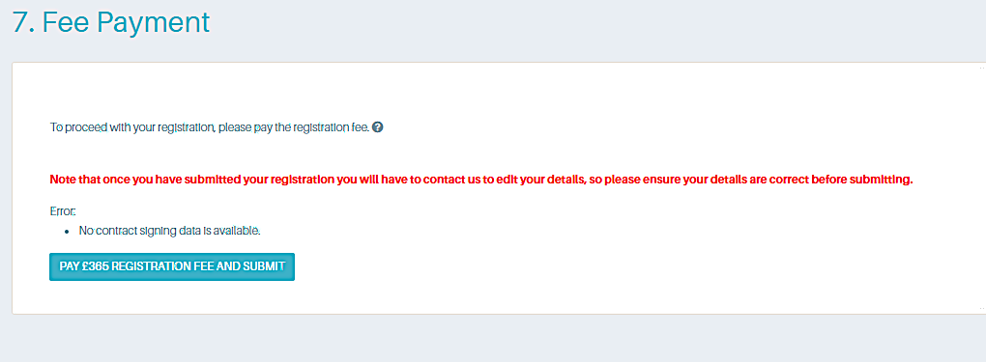
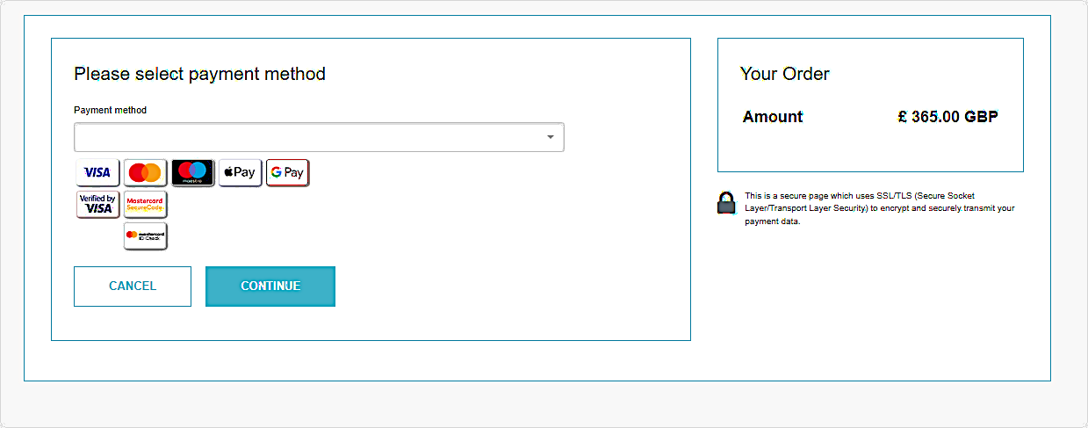
Fee Payment
Click the blue button to pay the £365 registration fee
Select payment method and enter card details.

Slide 41
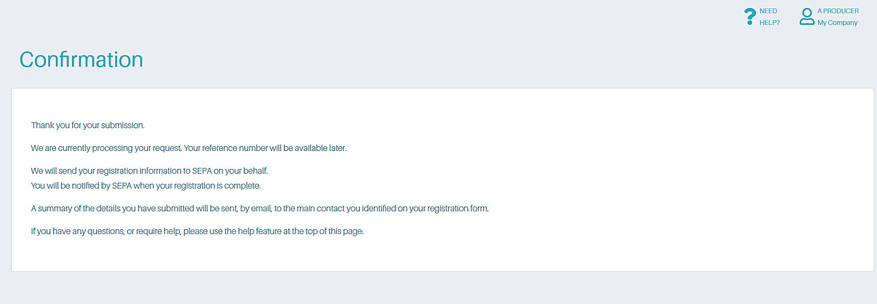
Confirmation

Slide 42
Need Help?
There is a ‘NEED HELP?’ button at the top of every screen should you require support during the registration process.

Slide 43
RPO and Hospitality Registration

Slide 44
Retailers’ Obligations
Only sell drinks from registered producers
Only sell drinks to consumers in Scotland that a producer has made available for sale in Scotland
Charge the 20p deposit when selling a drink that is part of the scheme
Make it clear to the customer that the drink is part of the scheme and a deposit applies

Slide 45
Retailers’ Obligations
Clearly display the price of the deposit (20p) in any place that a drink is displayed for sale
Clearly display information on how the customer can redeem the deposit
Operate a return point (unless exempt) or takeback service (further information on takeback available on Online retailer page)
Store returned empty containers in a safe way, following the Duty of Care code of practice

Slide 46
Hospitality Obligations
Only sell drinks from registered producers
Only sell drinks to consumers in Scotland that a producer has made available for sale in Scotland
No need to charge the deposit if drinks are intended for sale on the premises
Pay the 20p deposit to your supplier for each scheme article purchased
Store empty containers in a safe way following the Duty of Care code of practice

Slide 47
RPO/Hospitality Registration Process
If a retailer is not applying for an exemption they must operate as a Return Point Operator.
RPOs need to register in order have materials collected and receive Return Handling Fees and Deposits.
As part of the registration process RPOs need to confirm:
  their location(s)
  the type of Return Point they are planning to operate
We recommend that you sign up to our secure document portal
  a wide variety of information and resources
During the registration process you will be asked to provide details to support efficient collection scheduling as follows:

Slide 48
Requirements | Details of Requirements
Operating hours | Provide details of location opening hours – Enables accurate collection scheduling & avoids missed collections
Access | RPO must ensure collection operator can safely access the collection point without issue. Provide details of access constraints – Enables accurate vehicle planning, route optimisation & supports quicker collections
Collection Area | Provide details of space availability / where materials will be stored / collection area should be clear of obstruction and easily accessible / material should be stored in a secure area – supports quicker collections & avoids any uplift refusals by BIFFA
Restrictions | Details of any local council restrictions for vehicle access / vehicle parking & parking – optimises route planning/collection times/vehicle planning
Scheduling | RPO to ensure material is available for collection as per uplift schedule – Avoids missed collections/ additional costs/delay in payment
Out of Hours | Provide details if material for collection can be accessed out of hours – Supports efficient route planning
RVM Sorting Configuration | Source segregated material or co-mingled PET/Alu
Volume | Expected quantities of returns – number of bags, totes, bins per week
RPO/Hospitality Registration Process

Slide 49
Exemptions

Slide 50
Exemptions
Updated guidance issued by the Scottish Government on 3rd November 2022
Two types of return point exemptions are available:
  Proximity exemption
  Environmental health exemption

Slide 51
Proximity Exemptions
Relevant if:
There is an alternative return point within reasonable proximity that still ensures:
  reasonable access to a return point to your customers, AND
  the alternative return point operator has agreed to take returns on your behalf, AND
  the alternative return point operates at similar opening times and provides the same level of accessibility as your premises
Return Point Mapping & Extended Support - ZWS website:
  to find alternative return points near you
  if you want to act as an alternative return point

Slide 52
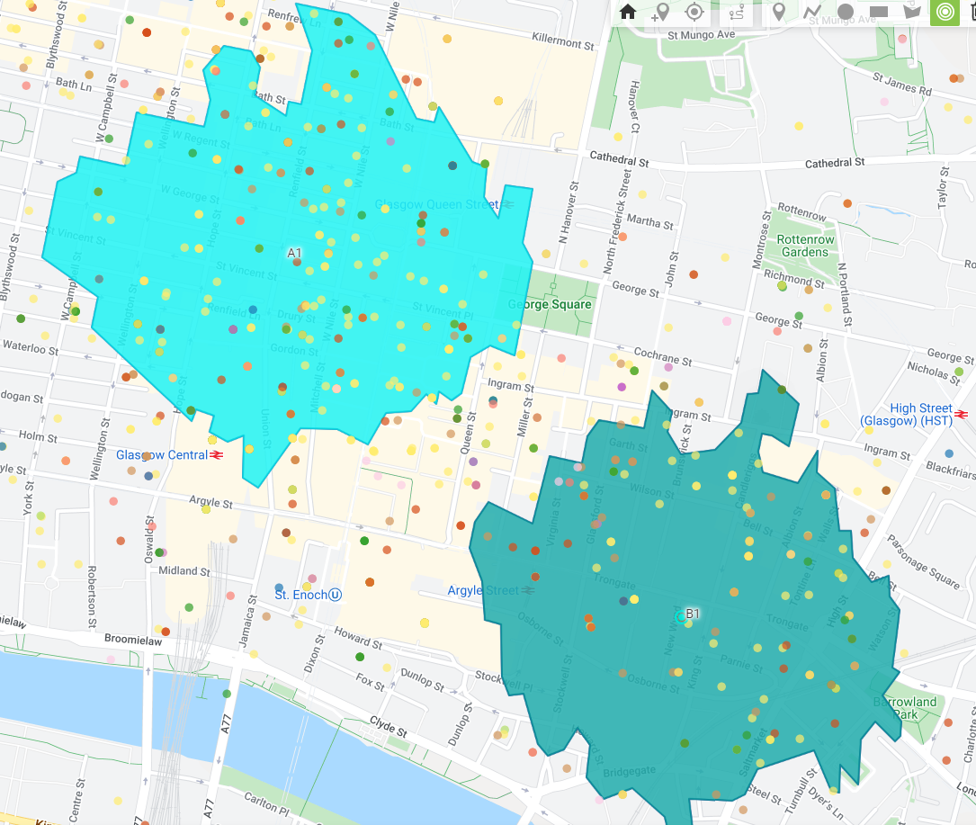
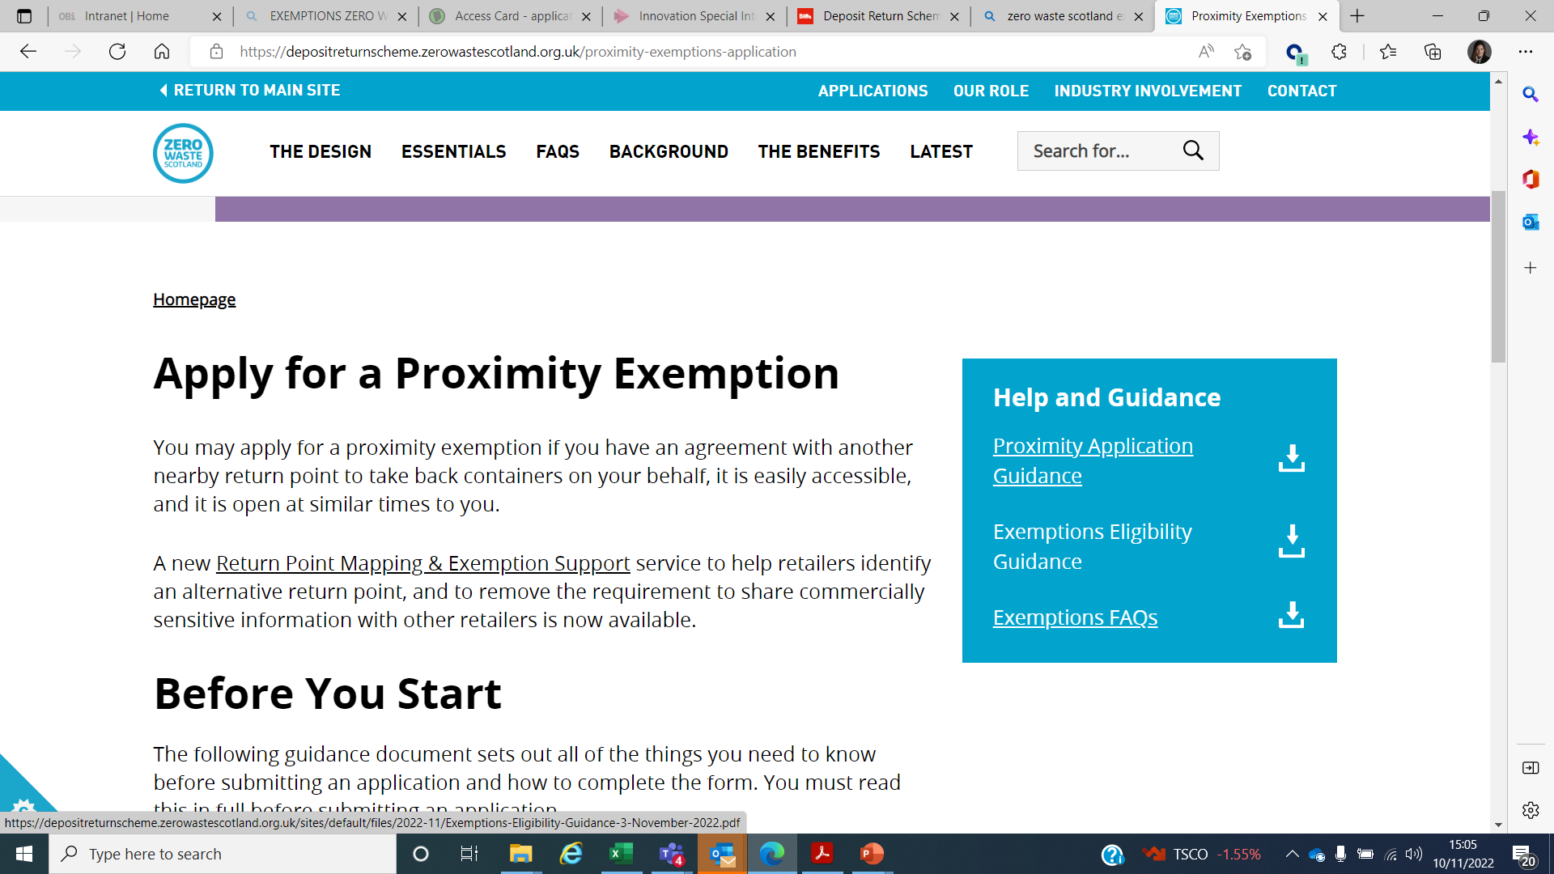
Mapping Tools
A mapping tool designed to support the proximity exemptions is available on the ZWS website
This forms part of the exemption process to facilitate the sharing of return points to support the proximity exemptions

Slide 53
Environmental Health Exemptions
ZWS website:
If you can demonstrate that operating a return point puts your business in breach of other legislation, such as environment health, food or fire safety.
The environmental health exemption application now focuses on a premises’ internal footprint.
  A retailer is likely to be approved for an environmental health exemption if the footprint of their premises is 100m² or less OR
  If they are a food-to-go retailer and the footprint of their premises is 280m² or less and operating as a return point would put them in breach of environmental health obligations

Slide 54
Cutover

Slide 55
What is Cutover?
The process of transitioning from current methods for drinks production, distribution and sale to those that will operate under the DRS Regulations from Go Live on 16th August 2023.
All players comply with the regulations
Support consumers, to maximise uptake
Minimise costs/cashflow issues for everyone

Slide 56
Why is the Cutover period important?
A well planned, smooth transition will help minimise costs and cashflow issues for everyone
It will ensure all participants comply with their new legal obligations
It will ensure the right type and timing of support is provided to consumers so they are clear what they need to do as Cutover progresses

Slide 57



Managing the production, stock and sale of the various types of products
SKU
Type
Go Live
16 August 2023
Post
Go Live
Scheme
Article
Existing
UK SKU
REAN
Existing
Scottish
SKU
REAN
New
UK SKU
NEAN
X
OEAN
New
Scottish SKU
KEY:
REAN - Retained EAN
NEAN - New EAN
OEAN - OLD EANs
NEAN
OEAN
X
Figure 1: SKU Types Pre-Go Live and Post-Go Live

Slide 58
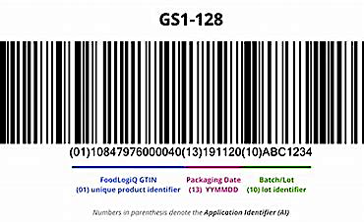
13 Dec - 28 Feb
Producer Registration
Register Company Details
Producers
Sign Producer Agreement
Register Products
Ensure GS1 Barcode on all Products
Submit Annual Forecasts
Consumer Marketing Campaign
DEC
2022
JAN
2023
FEB
2023
MAR
2023
APR
2023
MAY
2023
JUN
2023
JUL
2023
16 AUG
2023
Ongoing from March
Return Point Operator Registration
Return Point Operators
Register Company Details
Provide Collection Location
Specify Type: Manual / RVM

Slide 59
Mythbusters

Slide 60
Myth 1
Circularity Scotland said I had to complete registration by 17th February even though SEPA’s deadline is 28th February

Slide 61
Response 1
This is not true
Producers can register with Circularity Scotland up to the end of the statutory registration window i.e. 28/02/23.
We request producers to register with Circularity Scotland as early as possible during the registration window.
10 days is to ensure that we have plenty of time to get the details and payment to SEPA.
Be assured - producers can register up until 28th February.
Applications received near the closing date may result in a delay in an outcome decision of the registration

Slide 62
Myth 2
The DRS is going to be delayed

Slide 63
Response 2
We are moving forward with go-live on 16th August
If you want to continue selling products into Scotland you need to:
    register as a producer
    register your products prior to go-live.
If you are not registered for DRS you will no longer be able to sell single-use drinks into Scotland

Slide 64
Myth 3
All producers are required to pay thousands of pounds per month if the scheme is delayed in an unsecured loan

Slide 65
Response 3
Only applies to the very largest producers
If you put less than 10 million containers on the Scottish market per year - this does not apply to you
Producers that put more than 10 million containers on the market per year:
    fall into a specific band based on their total production
    would make payments up to the maximum of their band for no more than 2 years.
In the unlikely case of a delay, Circularity Scotland will reduce costs to producers as much as possible while still maintaining the integrity of the work completed to date.
It is in the producers' interest to continue to support the scheme as the producer will still need to fulfil their regulatory obligations with or without a scheme administrator.

Slide 66
Myth 4
As a Producer I need to pay Circularity Scotland the 20p deposit on all my containers, but then I don’t get those deposits back until consumers return their containers.
That could take months and some
may never return the deposits which means I lose out

Slide 67
Response 4
This is not true
You get the 20p deposit back as soon as you sell the product on
You will charge customers for the deposits of containers as well as the value of the product
They will charge the deposit when they sell the product on
This continues all the way until the product is purchased by a consumer who pays the shop the deposit
At that point everyone in the buying chain is cash neutral - the deposit costs sits with the consumer until they return the empty container to a DRS return point to redeem their 20p deposit

Slide 68
Myth 5
Circularity Scotland is in charge of the Deposit Return Scheme

Slide 69
Response 5
Circularity Scotland did not create the DRS regulations.
We are not a part of Scottish Government or UK Government.
We are not political.
We are not the regulator, that is SEPA.
We are not a public body - we're a private, non-profit commercial organisation established by industry
We are working with the same set of regulations as you.
Our role is to support producers and retailers and provide services to help them fulfil their regulatory obligations.

Slide 70
Myth 6
As a producer we've been given a target of achieving 90% returns on our products

Slide 71
Response 6
As your scheme administrator we take on this responsibility on behalf of the producer
By pooling everyone’s resources in a single scheme administrator, we can develop the most efficient and economical solutions
This will ensure that consumers are presented with a single clear and consistent identity so they know exactly what to do with their empty drinks containers.
This coherent approach is more likely to meet the Government’s aspiration of collecting more than 90% of Scotland’s drinks containers.

Slide 72
Myth 7
I have a product that doesn't have a barcode and it is so low volume that the producer won't add a barcode. Now I'II have to stop selling it in Scotland

Slide 73
Response 7
In exceptional cases, producers have the option to use barcode stickers.
Where a producer wishes to use barcode stickers on a Scheme Article, the Producer must seek the approval of Circularity Scotland prior to use.
Barcode stickers will only be permitted on lower volume Scheme Articles as notified by Circularity Scotland.
Barcode stickers will still require to be GS1 compliant.

Slide 74
Myth 8
Scotland's Deposit Return Scheme is unrealistic/unsustainable

Slide 75
Response 8
Scotland's Deposit Return Scheme is not unique
We're joining active DRS schemes all over the world
Deposit return Schemes will be implemented in every UK country over the next few years
In Europe alone there are currently 13 countries that have implemented DRS schemes
Over the next 3 years that number will grow to at least 29 European countries

Slide 76
Signposting

Slide 77
Circularity Scotland
https://circularityscotland.com/ - general information and link to sign up
enquiries@Circularityscotland.com – for specific questions
SEPA
https://www.sepa.org.uk/regulations/waste/deposit-return-scheme/ - detailed guidance for organisations affected by DRS
depositreturn@sepa.org.uk – address for enquiries relating to interpretation /coverage of the DRS regulations

Slide 78
Zero Waste Scotland
https://depositreturnscheme.zerowastescotland.org.uk/ - apply for Return Point Operator exemptions
Regulations
https://www.legislation.gov.uk/ssi/2020/154/contents - the regulations from 2020
https://www.legislation.gov.uk/ssi/2022/76/contents/made - amended regulations from 2022

Slide 79
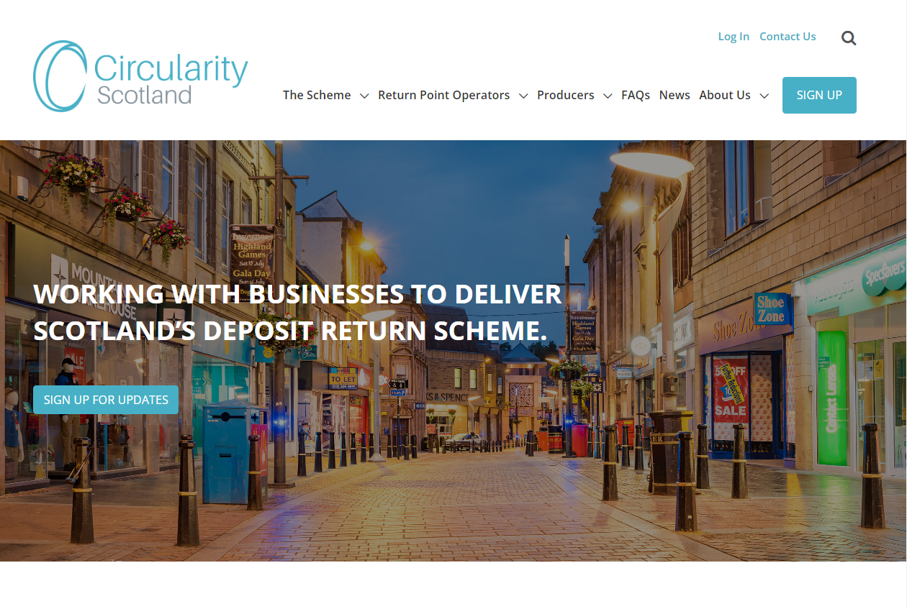
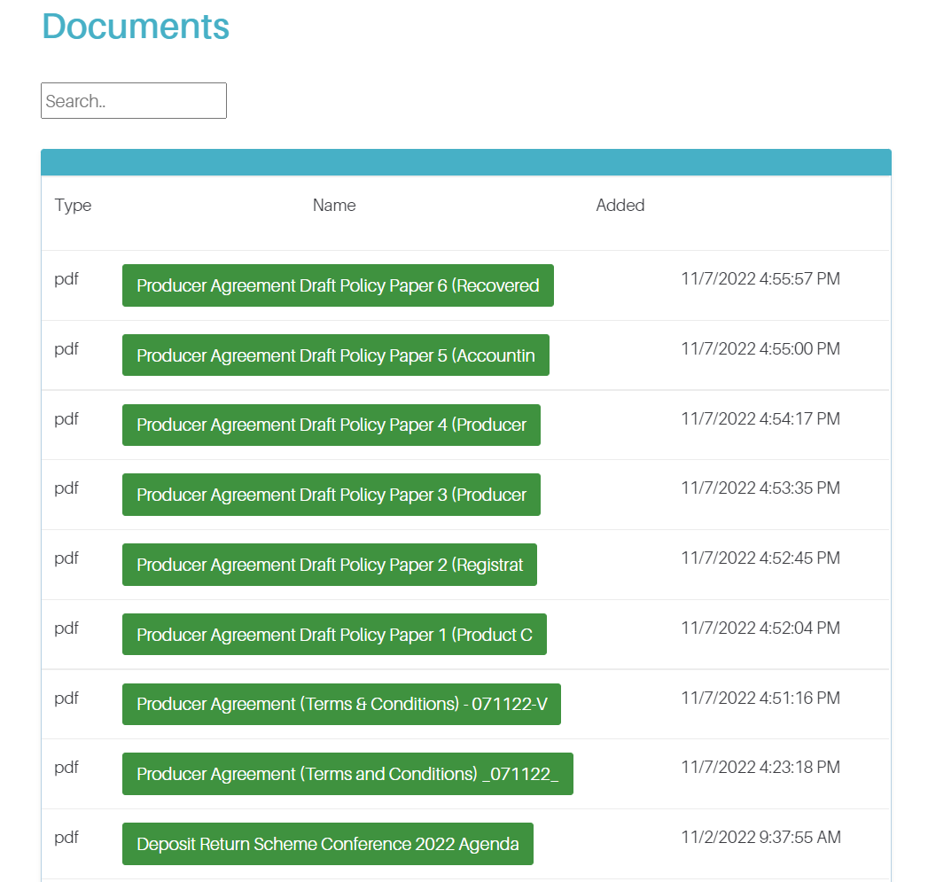
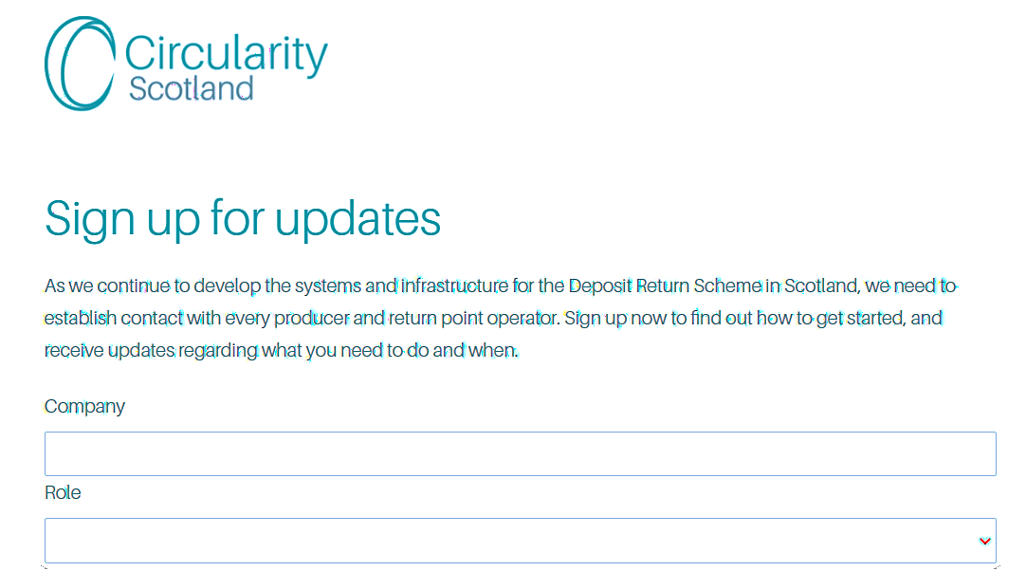
Here to help
W: circularityscotland.com
E: Enquiries@circularityscotland.com
T: Contact centre on 0141 401 0899

