Slide 1
SANTA CALLS
MFR PROPOSAL

Slide 2
IT’S SANTA CALLING…
MFR will be making the festive season extra special for some lucky children across the North Of Scotland as they will have the chance to speak to Santa live from the North Pole.
MFR will promote the campaign with on air promotional trails and presenter live reads.
Our listeners will be driven to your bespoke feature page at MFR.co.uk and this is where mums and dads will register their child to receive a call from Santa. Your feature page will have prominent branding and questions so Santa knows what the wee ones want for Christmas.
Once we have the online entries we will pick 5 children at random and play out their chat between 4-5pm on the Homerun with Martin and Travel Amy on the 23rd December.
You will also receive a 10 word tag with your promotional trails to highlight your brands key messages.

Slide 3
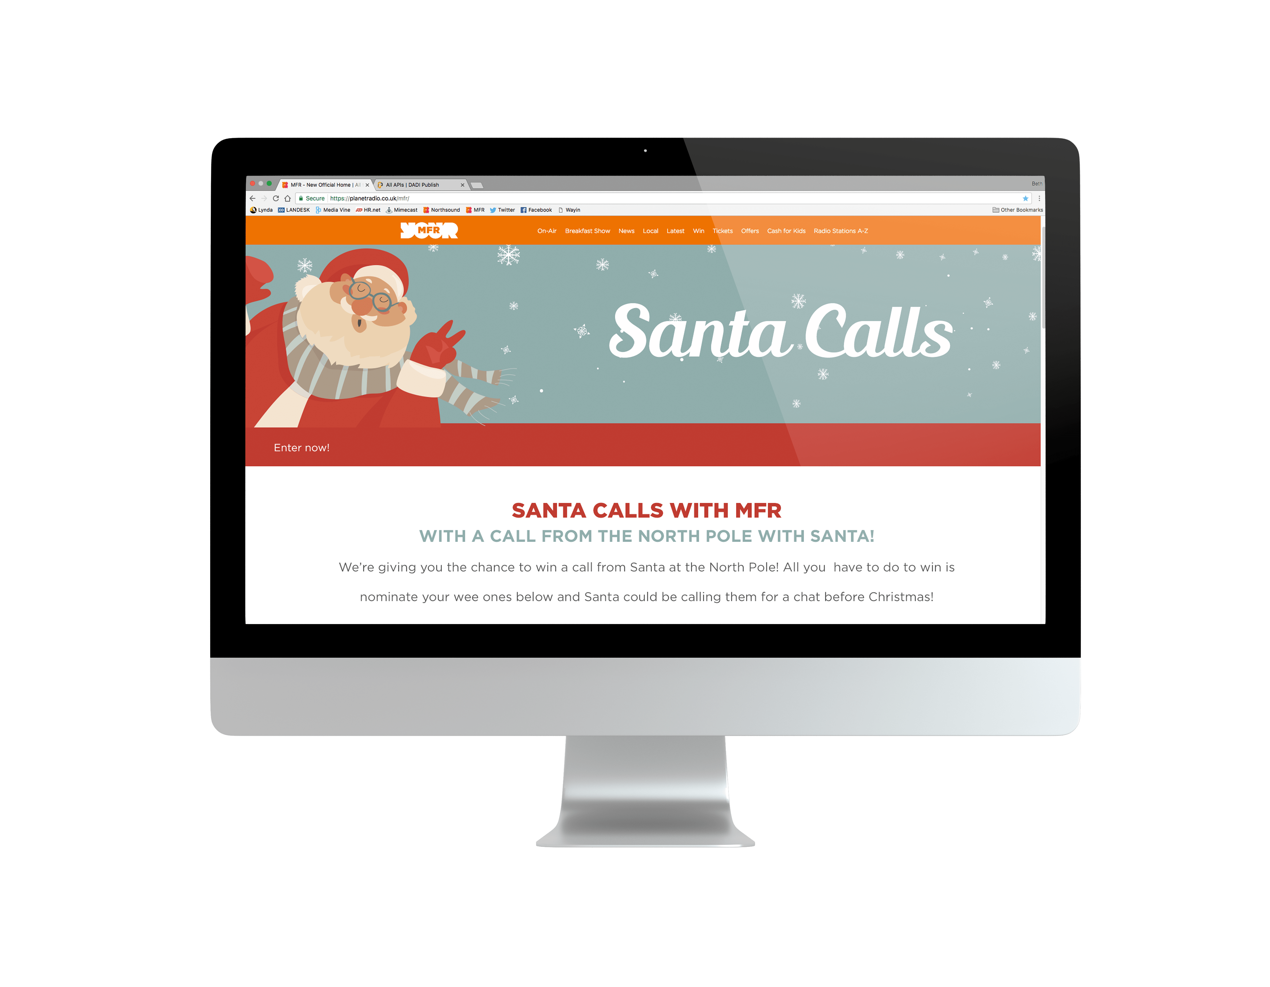
MFR PROMOTION
AIRTIME DELIVERY: 10 Days
439.586
Impacts
4
112,322
Reach
45%
Reach
4
O.T.H
Source: RAJAR Q1, 2019. MFR TSA.

Slide 4
INVESTMENT
SUN | SAT | FRI | THU | WED | TUE | MON | LAYDOWN
5 | 5 | 5 | 6 | 5 |  |  | 0100 – 2359 30” PROMO TRAILS
1 | 1 | 1 | - | 1 |  |  | 0600 - 1800 LIVE READS
10 days on-air
52 on-air trails
8 presenter Live Reads
SUN | SAT | FRI | THU | WED | TUE | MON | LAYDOWN
- | - | 5 | 6 | 5 | 6 | 5 | 0100 – 2359 30” PROMO TRAILS
- | - | 1 | 1 | 1 | - | 1 | 0600 - 1800 LIVE READS
Campaign will run from the 4th December until the 13th
INVESTMENT: £1500 + VAT

