Slide 1
Moray Chamber of Commerce Webinar
Moray Aerospace and Advanced Technology and Innovation Campus
(MAATIC)

Slide 2
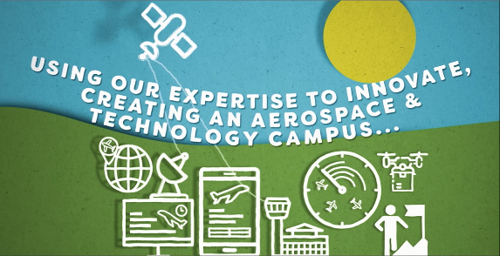
MAATIC - Project overview
Meet the immediate training and technology needs of existing Moray-based industries
Provide the skilled workforce requirements for the emerging aerospace sector
Support research into cutting edge developments in aviation

Slide 3
MAATIC - Project elements
New build facility near RAF Lossiemouth
Offers a range of UHI and license-to-practice Aviation qualifications
includes operational Boeing 737 and augmented reality simulation kit
Advanced Technology Research and Development Lab
covers a range of technologies, particularly those related to Aerospace
Atrium with flexible open space,
for community use including STEM activities
co-located with the HIE ‘MIM’ project
Manufacturing Innovation for Moray project

Slide 4
MAATIC - Objectives and benefits
Increase skills relevant to aerospace and advanced technology (minimum 340 people)
Attract/retain young people to the region (up 1%)
Increase inward investment into region (£40m)
Reduce inequalities and segregation in skilled employment in the region (targets for gender and disadvantage)
Allied research projects (minimum 15)

Slide 5
MAATIC – Engagement opportunities
Series of Communication and Engagement events being planned for the new year.
Opportunity for suggestions and questions today?

