Slide 1
Moray Chamber of Commerce Webinar
Early Years STEM

Slide 2
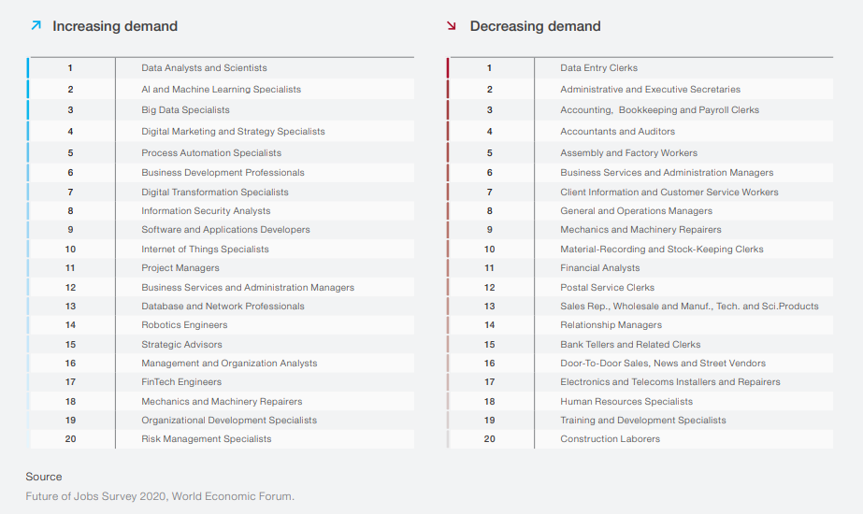

Slide 3
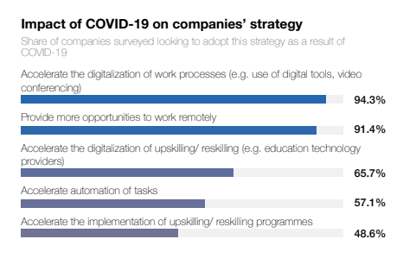
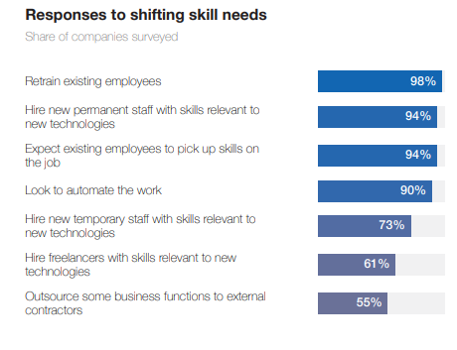
Source:
Future of Jobs Strategy 2020: World Economic Forum

Slide 4
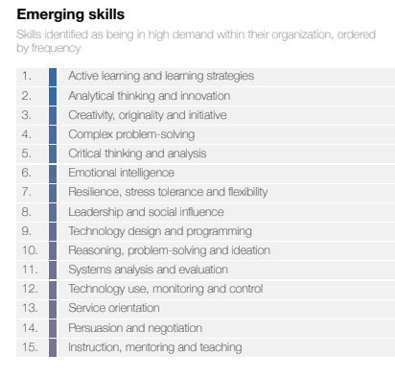
Source:
Future of Jobs Strategy 2020: World Economic Forum

Slide 5
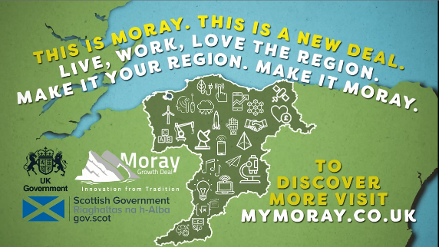
STEM - Objectives and benefits
Investment Objective 1 – To increase the availability of STEM opportunities for younger people and encourage STEM uptake through family engagement.
Investment Objective 2 - To increase the number of STEM qualifications achieved at secondary level, uptake at further and higher education and ultimately increase the STEM skill level in Moray
Investment Objective 3 - To ensure there is equality of opportunity in STEM education across Moray

Slide 6
STEM - Project overview
To support Moray’s aspiration to be sector leader in the development of Early Years STEM (Science, Technology, Engineering, and Mathematics), the project will build on the innovative work of the Moray Skills Pathway and RAiSE (Raising aspiration in Science Education) programmes.
This investment will support the development of creative hubs as a means of breaking down the barriers to STEM in young people (particularly ages 3-8), and ultimately improving interest and participation in STEM, particularly amongst women.

Slide 7
STEM - Project elements
TO BE CONFIRMED
Fixed facilities within each of the 8 Associated School Groups
A Mobile Solution with changing industry focus
Public/Private partnerships to allow STEM education to happen at industry locations
Culture change in how STEM is viewed within Moray
Increase confidence and capability in STEM delivery in education practitioners.

Slide 8
STEM – Engagement opportunities
Series of Communication and Engagement events being planned for the new year.
Diverse project board helping to shape the project
Opportunity for suggestions and questions today?

