Slide 1
Moray Chamber of Commerce Webinar
Bus Revolution

Slide 2
Bus Revolution - Project overview
Build on the existing innovative on-demand bus services to provide comprehensive and cohesive public transport links tailored to the region’s largely rural economy.
The purpose is not to compete with scheduled services but to fill the gaps in provision in rural areas and to encourage more people to use public transport rather than use private cars in line with the Scottish Government priority to reduce carbon emissions.

Slide 3
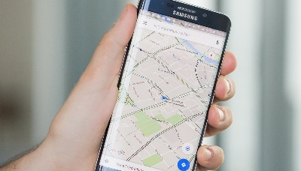
Bus Revolution - Project elements
The development of an “uber-style” app to enable customers to track the position of buses and book journeys within a reasonable response time.
An investment in quality green fleet (electric buses), to increase the flexibility and hours of operation of on-demand bus provision across Moray, with additional facilities such as on board Wi-Fi, charging facilities etc.

Slide 4
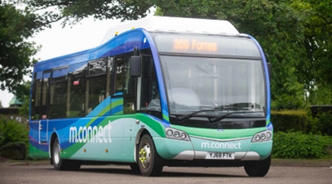
Bus Revolution - Objectives and benefits
Increase the number of people using public transport to get to and from rural areas to places of work, education, etc.
Reduce the environmental impact of transport in the area.
Remove significant barriers to labour market access and education by providing more efficient and accessible local bus services.
Potential to engage with larger employers in the area regarding employee workplace transport.

Slide 5
Bus Revolution – Engagement opportunities
Currently finalising the first draft of the Outline Business Case, but looking to engage with businesses and the community during the next few months to gain views on the proposals for input to the final version by February 2021.
An online survey is being promoted for residents in Moray to give views on the project and specifically elements that would encourage them to increase usage.
Will be looking for employers to engage regarding potential for workplace travel and will be scheduling a follow-up session for interested parties in early December.

