Slide 1
Moray Chamber of Commerce Webinar
Cultural Quarter

Slide 2
Cultural Quarter- Project overview
Culture-led regeneration is an emerging trend amongst many UK cities and towns
There is strong evidence that investment in culture and creativity has the potential of generating socio-economic impacts such as strengthening communities and skills, increasing employment and boosting tourism.

Slide 3
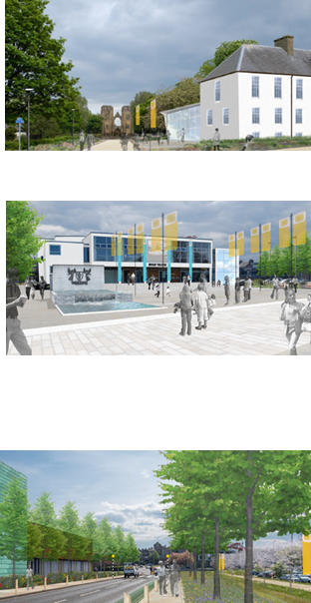
Cultural Quarter - Project elements
Refurbishment of Grant Lodge to create a high quality heritage attraction; designed to increase the number of visitors to Moray and encourage people to stay longer in the area.
Refurbishment, extension, and rebranding of the Town Hall to house a multi-purpose theatre/ performance space, small cinema, rehearsal rooms; to create an improved cultural offering and support local creative industries.
Provision of a high quality hotel; to address a much-needed and long acknowledged market gap in the region’s tourism infrastructure, and open up Moray’s tourism industry to new markets.

Slide 4
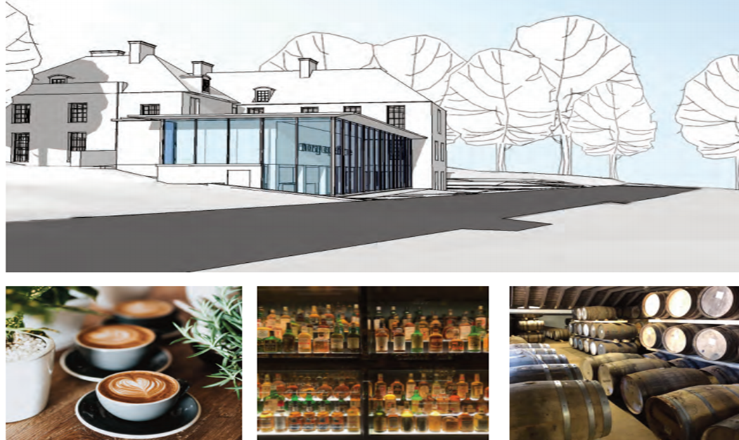
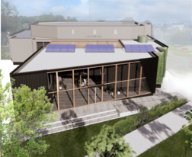
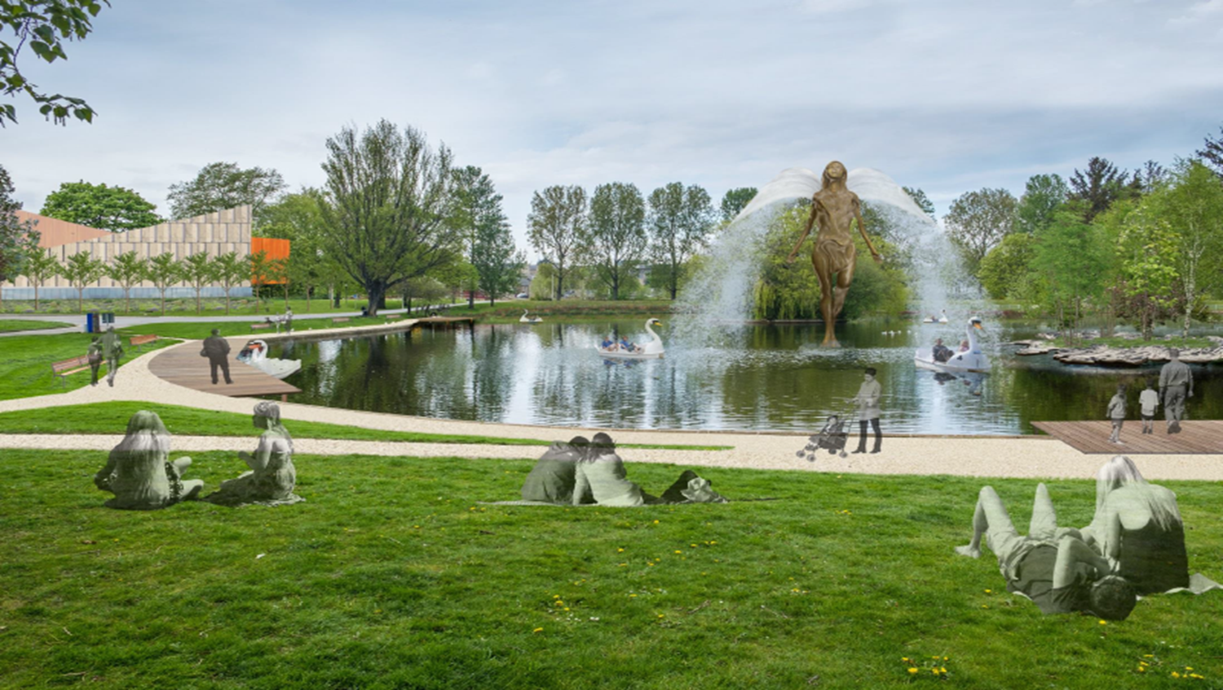
Cultural Quarter - Objectives and benefits
Increase tourism in Moray by providing a focal point to draw in additional visitors and signpost them to attractions right across the area.
Create an enhanced cultural and evening economy offering which will help to attract and retain young people in the area.
Increase the number of start-up businesses in the tourism/creative sectors.

Slide 5
Cultural Quarter – Engagement opportunities
Extend the local consultation process to involve more users and/or interested parties to engage regarding development of the facilities at both Grant Lodge and Elgin Town Hall and will be scheduling a follow-up session for interested parties in early December.

