Slide 1
Digital Health and Care programme
Moray Chamber – Nov 2020
Janette Hughes – DHI Director of Planning and Performance

Slide 2
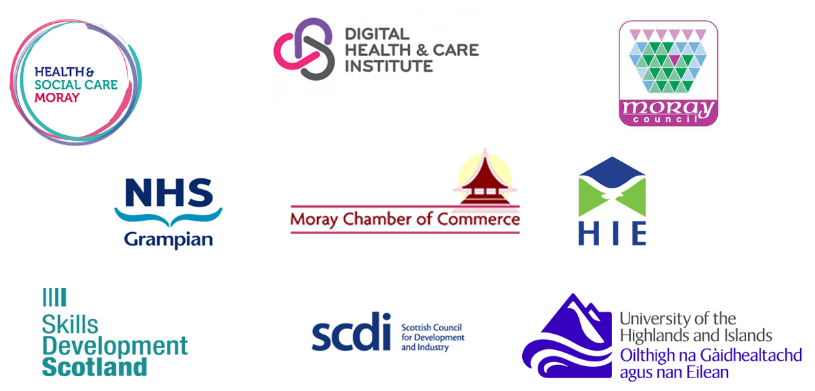
Our vision partnership working
Notes:
Our joint vision presented to you today is to anchor a DSE facility in the Alexander Graham Bell building in Elgin, whilst offering living lab test beds within the region, using your population as testers and co-designers whilst working to a quadruple helix model – Civic, Industry, Academic and citizen,,,,,,,,

Slide 3
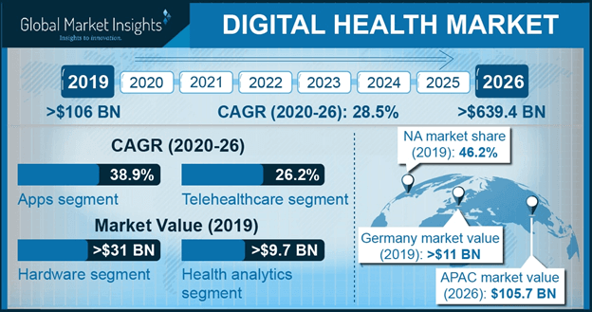
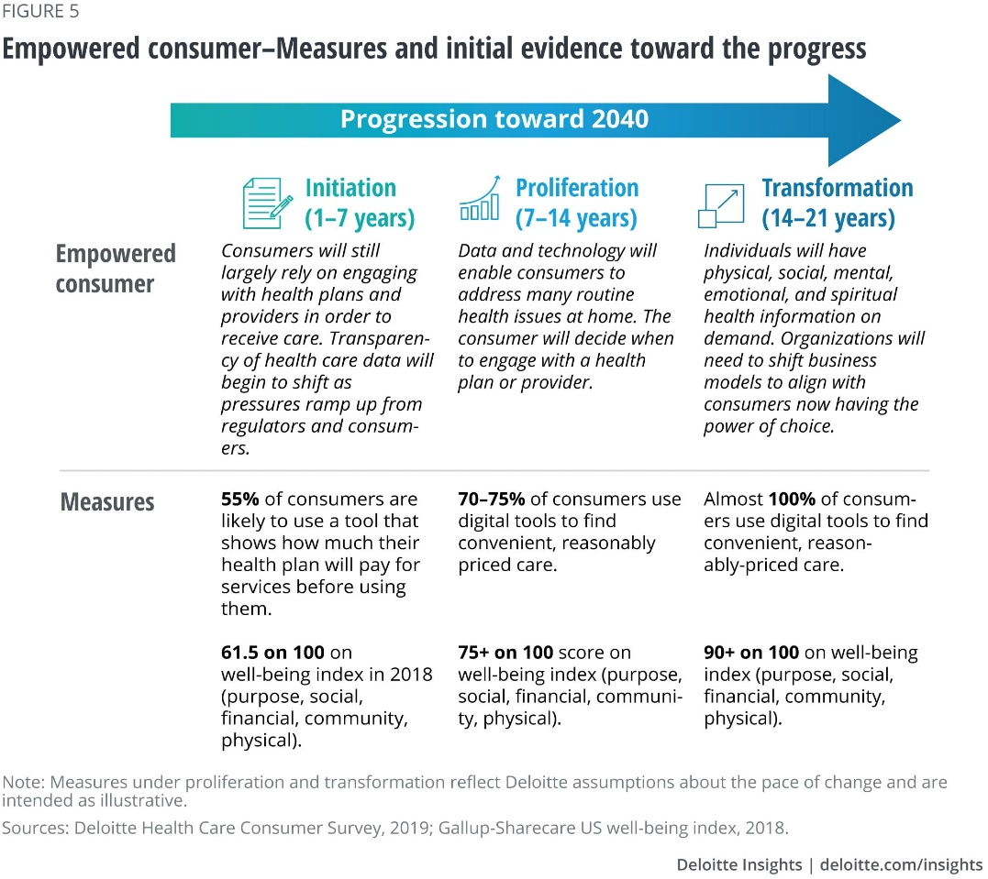
The opportunity for Moray
Globally, digital health & care is one of the fastest growing economic sectors.
Digital Health is not just an economic development opportunity it is also offers the opportunity to provide better services and support for the individual and contribute positively to challenges facing the public sector relating to the sustainability of the health and care service.
This includes support for independent living, more effective service provision, and reduced costs to service through improved self-management of long-term conditions.
In reviewing not only the local, national and international opportunities and high demand areas for innovation for digital health and care, seven key local priorities areas have been identified – which include supporting the remobilisation of services and the economic recovery – post covid-19.

Slide 4
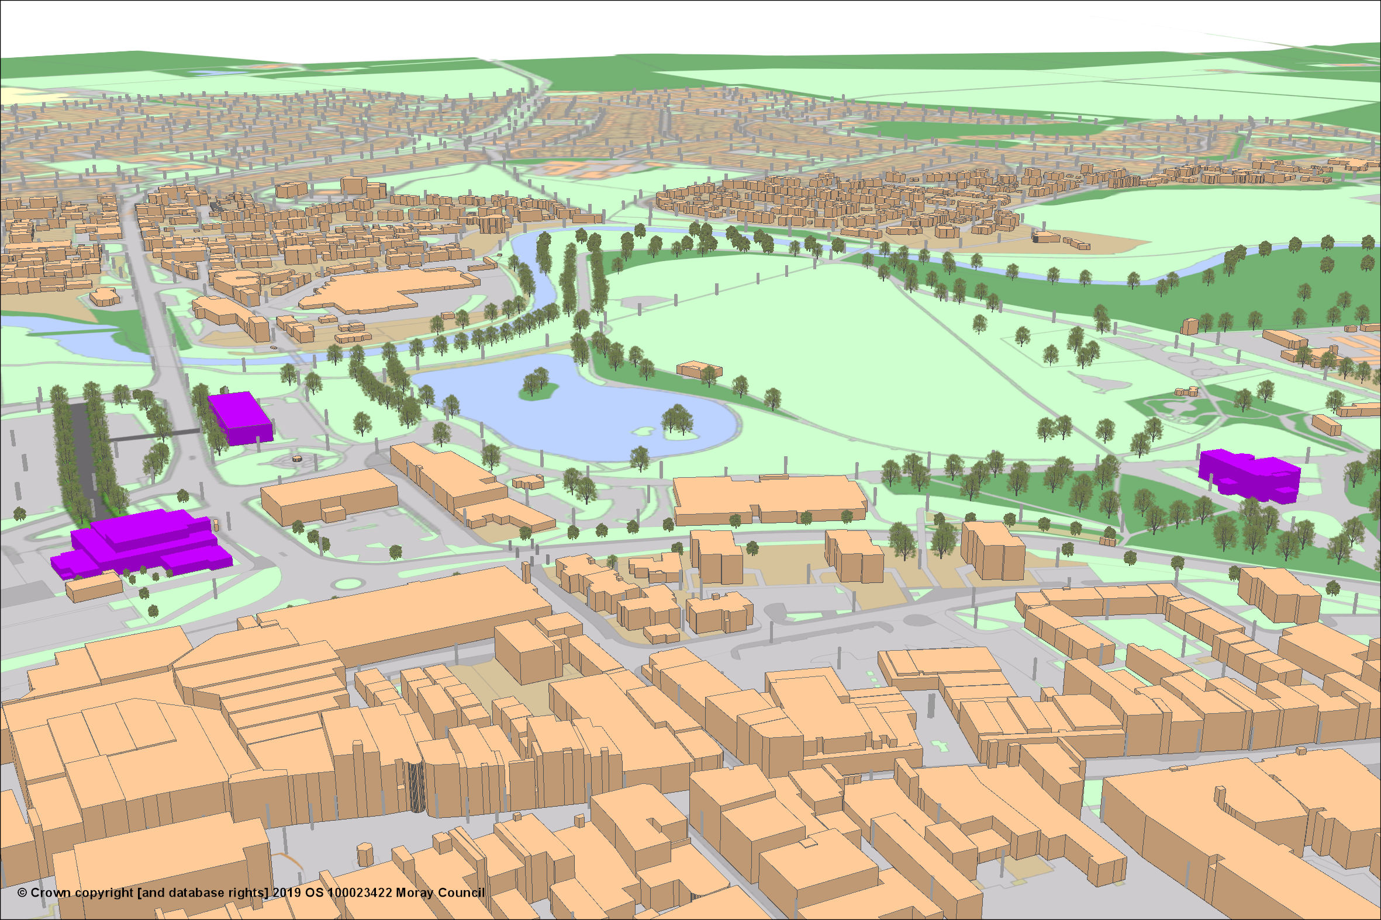
The overarching objectives
Digital Health and Care programme – Key elements
To deliver a ‘Rural centre of excellence’ for Digital Health and care’ with a Demonstration and Simulation environment anchored in Elgin – Alexander Graham Bell building and then extend testing through multi stakeholder bids for living lab deployments – accelerating service innovation and the remobilisation of services (post Covid-19) to embed digital for community benefit and advance future student education and skills for the workforce
Increase inward investment by attracting leading Digital health and care industry partners to Moray by providing a focal point to draw companies to incubate and increase R&D and high value employment opportunities - economic development and recovery – post Covid-19.

Slide 5
Key themes
Care in place – including circle of care within the community
Citizen empowerment – in particular around data - person held data and co-managed records
Supported Self-management – including wellbeing (activity monitoring)
Diagnostics and Early warning innovations
Smart communities/Smart Housing – link to Housing Mix project
Mental Health/Wellbeing
Emergency response

Slide 6
Supporting Industry to grow
FUTURE STATE SERVICE VISUALISATION
INTERFACES
Technical
Service User
INTERFACES
DEVICES & APPS
EVIDENCE BASE
Management
Practitioner
USER STORY and CODESIGN VISUALISATION
Notes:
As mentioned within the document, Glasgow is pioneering this approach with startling results and endorsement from Scottish Governments ehealth experts, with DHI written into the Digital health and care strategy but more importantly in attracting Industry large and small, with one major blue-chip company recently quoting that they have visited many sites in the UK who claim to be innovating within this domain, but he was stated ‘we are head and shoulders ahead and really meeting the gap in the market of accelerating access and simulation’ – which is resulting in a new strategic partnership being established.

Slide 7
Benefits – Inclusive Growth ECONOMIC – SERVICE – SKILLS
Increase the number of high value jobs and inward investment in the Moray region.
Create a space and infrastructure for partners in Moray to simulate the service demands and potential solutions by innovating collaboratively within the Demonstration and Simulation environment that can exchange knowledge, ideas and data to imagine what is possible with the use of digital.
Create min of 5 Real-World Living Lab (co-design) test bed facility/opportunities in Moray to prove in partnership (i.e. consortium) the service, technical and business innovation can be adopted. Providing evidence to allow implementation, scale and commercialisation to occur.
Increase the skills and education levels in relation to Digital Health and Care Innovation, providing future career opportunities and influencing educational curriculum and CPD for new or existing staff within this sector and promoting the opportunity for new skills, as per the Covid-19 recovery phase.
Improve services by realising at least two digital innovations within the local NHS, IJB, Local authority and/or 3rd sector partners services, to enable them to be fit for the future, bringing benefits to the citizen and the services in Moray.

