Slide 1
Moray Chamber of Commerce Webinar
Housing Mix Delivery

Slide 2
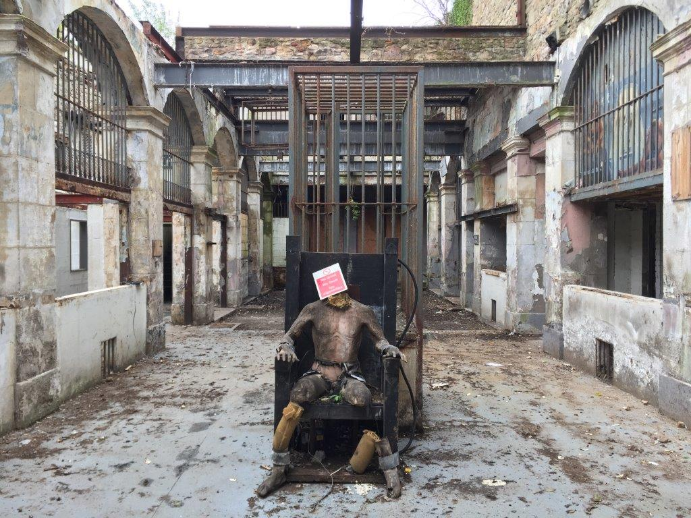
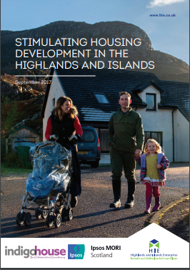
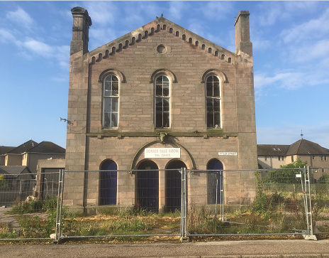
Housing Mix Delivery - Project overview
Overcoming barriers to deliver housing
Town Centre regeneration, vacant, derelict, rural housing need, exemplar carbon conscious
Link with public health reform and digital health project
Local supply chain, increase number of small scale developers, low cost home ownership

Slide 3
Housing Mix Delivery – Draft Investment Objectives & Benefits
1. To release constrained housing sites and support delivery of 360 affordable homes by 2030, range of tenures, innovative design solutions, maximising use of local materials, in/ adjacent to Town Centres, rural villages and unlock sites & simplify regulatory processes for the development of 500 private houses.
2. To build a first phase carbon conscious affordable housing development using innovative design solutions at Dallas Dhu, Forres or Findrassie by 2025.
3. To create 2 Real World Environments to test digital health and care innovation by 2025 and create developments which have a positive impact on the health and wellbeing of communities.
4. To prepare and implement Local Outcome Improvement Plans in newly formed communities by 2030, involving the local communities in the design process and offering multi agency support post construction for training, education, employment and community formation.

Slide 4
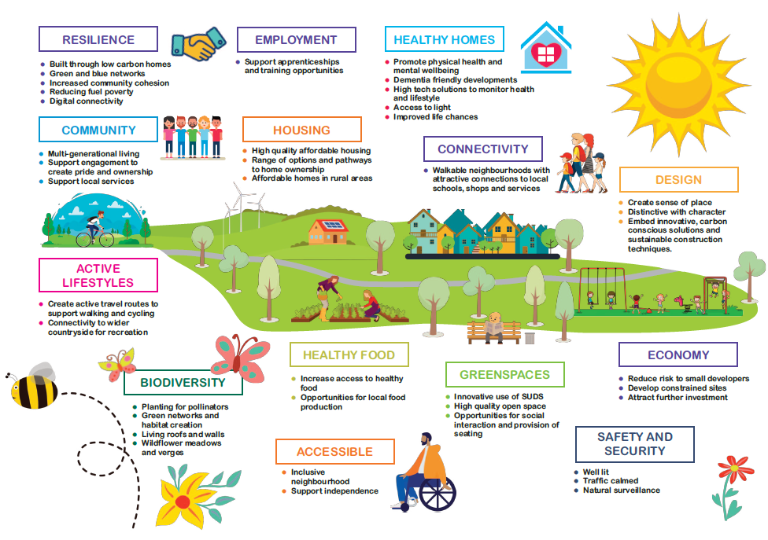

Slide 5
Housing Mix Delivery – Engagement opportunities
Commissioning design work for sites, public consultation
Elgin City Centre Masterplan (draft) public consultation early 2021, Elgin BID and ECC
Housing need surveys at appropriate stages of project
Homes for Scotland, NHS Grampian and Digital Health Institute are on the Board

